Slide 1


Vehicle Control Unit (VCU)
Final Review
AY 2025-26
Capstone Project – Introduction (PROJ2999)
GITAM (Deemed-to-be) University
Department of Electrical Electronics and Communication Engineering
Project Team:
Shravani C L
Ch Pavan Kumar
P Janardhan Reddy
Project Mentor:
Dr. Seetha Chaithanya
Project In-charge:
Kshitij Shakya
www.gitam.edu

Slide 2
Objective and Goals
Objective
To implement and control the BLDC Motor with a programmable VCU and integrate it with BMS to manage the powertrain, battery and associated subsystems for EVs.
Goals
Main Goals
Act as Brain of the Electric Vehicle
Read Driver Inputs
Driver Command Processing
BMS Coordination
Power Distribution and Safety
Additional Goals
Learn about STM32 Microcontroller
Data Logging
Diagnostics and Monitoring

Slide 3
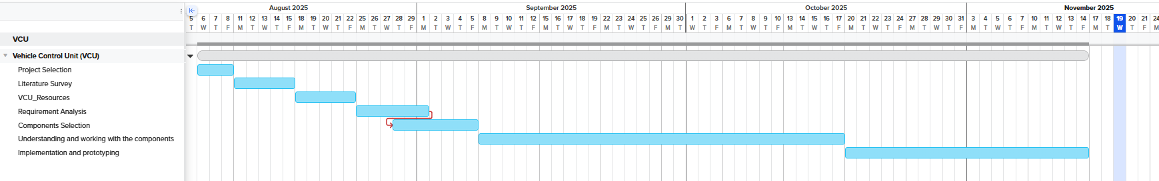
Project Plan
Gantt Chart - Milestones and Activities
Resources : https://www.officetimeline.com/gantt-chart/how-to-make/excel & https://www.teamgantt.com/
Fig 1: Gantt Chart

Slide 4
Literature Survey
S.No | Article | Authors | Published On | Description
1 | Evolving Electric Mobility Energy Efficiency: In-Depth Analysis of Integrated Electronic Control Unit Development in Electric Vehicles | Syed Shehryar Ali Naqvi, Harun Jamil, Naeem Iqbal, Salabat Khan, Murad Ali Khan, Faiza Qayyum, Do-Hyeun Kim | 22 Jan 2024 | Comprehensive review of integrated ECUs in EVs, examining development approaches, algorithms, subsystems (VCU, EPS, ESC, BCU), their roles in energy efficiency, real-world applications, and future research directions.
2 | Automotive Software in Connected and Autonomous Electric Vehicles: A Review | Hrvoje Vdovic, Jurica Babic, Vedran Podobni | 27 Nov 2019 | Summarizes the architecture of ECUs, the importance of centralized software for VCU, AUTOSAR, drive-by-wire, and modern EV control strategies; highlights trends and challenges in software-driven VCU development.
3 | Requirements-Driven Automotive Electrical/Electronic Architecture: A Survey and Prospective Trends | Hailong Zhu, Wei Zhou, Zhiheng Li, Li Li, Tao Huang | 21 Jul 2021 | Reviews state-of-the-art and future trends in automotive electrical/electronic (EE) architecture, zone-based and centralized computing, software-driven VCU evolution, and implications for integrating advanced control units.
4 | Electronic Control System Design and Test of Pure Electric Vehicle Battery Management System | Yeqin Wang, Yixing Liu | 2011 | Modular BMS and ECU integration using CAN and RS485 communication, with real-time battery data collection, fault diagnosis, and SOC estimation for vehicle control units.
Table 1: Literature Survey

Slide 5
Resources:
Manufacturers:
1. Electra EV
2. Saietta VNA + HCLTech (India)
3. NXP S32K VCU Solutions

Slide 6
Block Diagram
Fig 2: Block diagram representation of VCU along with ECU

Slide 7
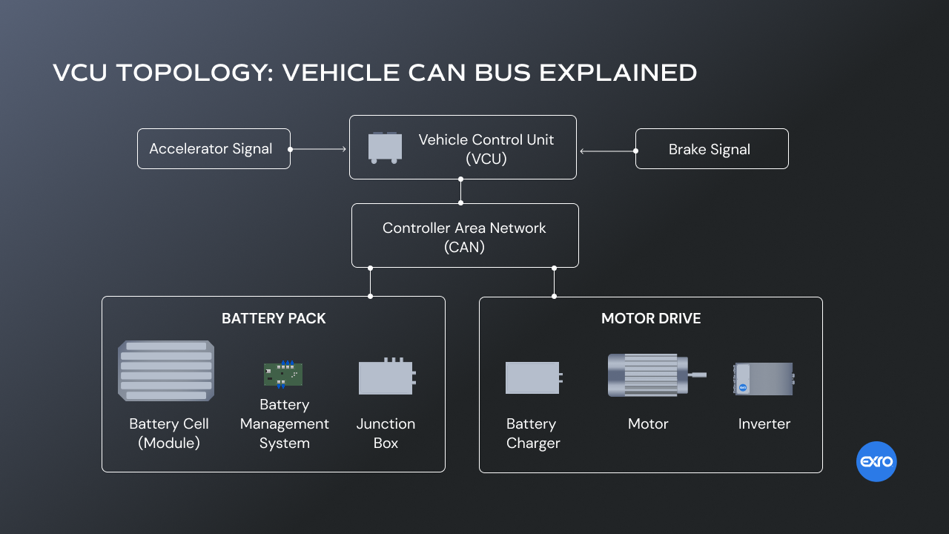
Block Diagram Continuation…
Fig 3: Proposed block diagram representation of VCU

Slide 8
Use Cases & Testing
Test Cases
Turn ignition ON->VCU checks system readiness-> READY LED ON
Vary accelerator potentiometer -> Torque command on CAN -> Motor RPM increases proportionally
Simulate SOC < 20% from BMS -> VCU limits torque or blocks DRIVE mode
Disconnect CAN to Inverter/BMS -> VCU detects timeout -> Enters FAULT, disables torque
Turn ignition OFF -> VCU disables contactors, motor stops, system enters OFF state
Use Cases
Vehicle Startup (OFF->Ready)
Driving (Torque Request)
Battery Monitoring (BMS)
CAN Communication loss
System Shutdown

Slide 9
Requirement Analysis:
Motor Control:
Fig 4: Schematic representation of Motor Control Unit
Estimation Parameters:
Control Torque/speed
Read brake pedal sensor %
Map brake pedal sensor% for Regenerative Braking
VCU monitors BPS or vehicle deacceleration

Slide 10
Battery Parameters:
Monitor
SoC, SoH
Charging current
Battery Temperature
Faults or warnings
Monitor SoC, SoH
Check for PLC, PP, CP
Stop charging when:
Target SoC reached
User unplugs connector
Faults or Warnings
Communications:
CAN 2.0 / CAN FD
OBD-II for diagnostics
Ethernet for future OTA upgrades

Slide 11
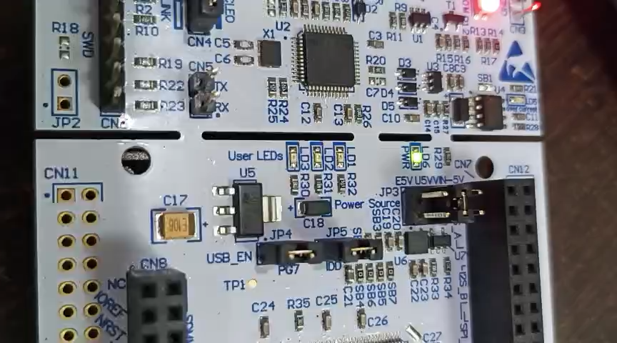
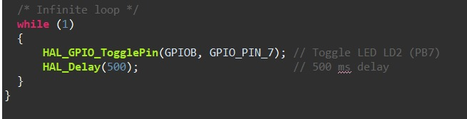
Implementation and Results – Iteration 1
In the first stage, our goal was to get familiar with the STM32F767ZI board and confirm that our development setup was working correctly.
Started with a simple LED blink program using the onboard LD2.
Configured the GPIO pin as output, set up the system clock, and wrote a basic firmware loop to toggle the LED with a delay.
This helped us understand how STM32CubeIDE, HAL drivers, and debugging tools work.
Code:
Fig 5: LED blink program code
Video 1: LED blink program
Result:
The LED blinked exactly at the delay interval we programmed, which confirmed that the board, compiler, and flashing process were all functioning correctly.
This successful test gave us confidence to move ahead with more complex tasks.

Slide 12
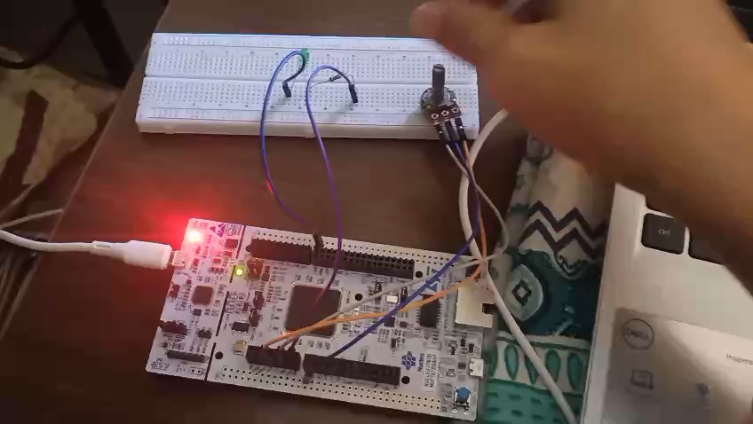
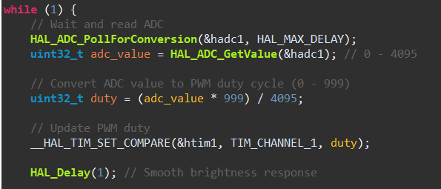
Implementation and Results – Iteration 2
After validating the basic LED blink, we moved to the next step — controlling the LED brightness using a potentiometer.
The potentiometer was connected to one of the ADC pins on the STM32 board.
We read the analog value and mapped it to control the LED brightness using PWM.
This helped us understand analog signal reading, ADC configuration, and PWM generation on STM32.
Code:
Fig 6: LED Potentiometer program code
Video 2: Controlling LED with Potentiometer
Result:
The LED brightness changed smoothly when we rotated the potentiometer.
This confirmed that the ADC was reading values correctly and PWM signals were being generated as expected.
This test helped us build confidence in reading sensor inputs and using them to control outputs — which is important for future VCU functions.

Slide 13
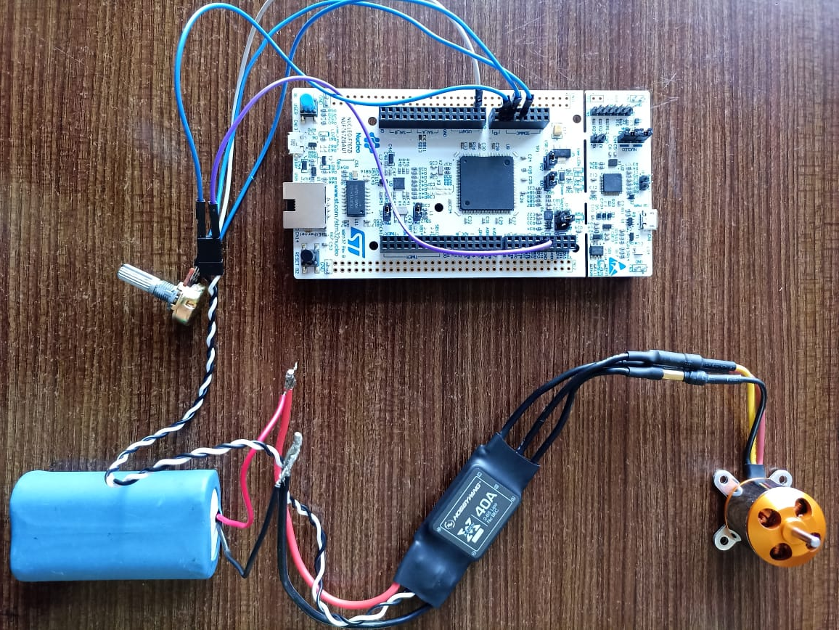
Implementation and Results – Iteration 3
Configured STM32 PWM pins for BLDC control
Connected PWM outputs to motor driver
Verified PWM signals on output pins
STM32 F767ZI MC
Potentiometer
Battery Pack
BLDC Motor
ESC Controller
Fig 7: Prototype arrangement
Result:
Signals were present but BLDC did not rotate.
Possible issues: driver enable pins, wiring, or startup duty cycle.
Debugging phase is in progress.

Slide 14
Conclusion & Future Work
Summary and Conclusion
In this review phase, we successfully tested the STM32 board through basic LED control, ADC-based potentiometer input, and PWM generation for BLDC motor control.
We verified that the microcontroller, GPIO, ADC, and PWM modules are functioning correctly.
Although the BLDC motor did not rotate, the signals were generated as expected, which helped us identify where the interfacing issue lies.
Overall, this stage gave us a strong foundation in understanding the complete signal flow and the control requirements needed for motor and battery management in a VCU system.
Future Work
We plan to debug and complete the BLDC motor control by fixing driver interfacing and phase wiring issues.
Our next step is to control a higher-rating motor to move closer to real vehicle-level performance.
We will also start interfacing and monitoring the Battery Management System (BMS) parameters such as voltage, current, SOC, and temperature.
Once motor and BMS control are stable, we will integrate both into the VCU workflow using CAN communication.

Slide 15
THANK YOU
Have a Great Day !

